Slide 1
Low cost VNA
Trinh Le Huy
HCM City, 22/09/2016

Slide 2
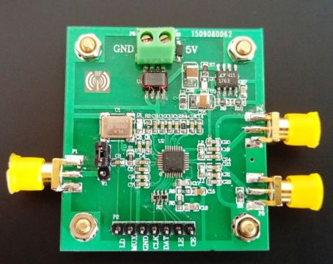
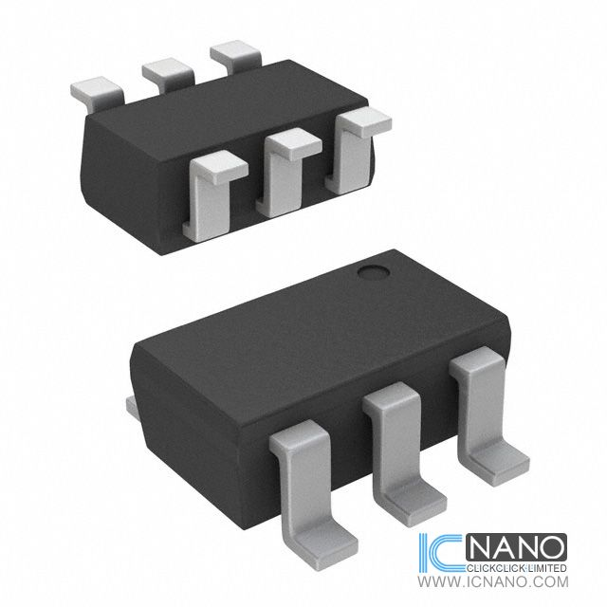
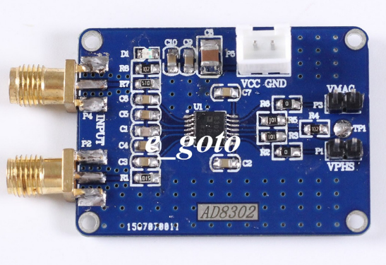
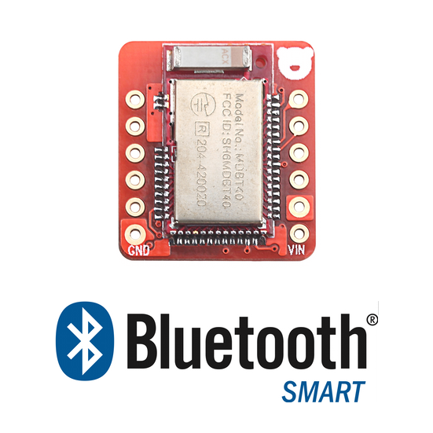
Block Diagram
DUT
#40$
2$
2$
ADF4350
PLL Frequency Synthesizer
RFin
DC08-73LF
Directional Coupler
DC08-73LF
Directional Coupler
Forward Coupled
Reverse Coupled
SPI
AD8302
Gain and Phase Detector
MCU + Transceiver
Phase
20$
Amplitude

Slide 3
References
http://www.ebay.com/itm/Output-frequency-137M-4-4G-signal-source-development-ADF4350-development-board-/281753222391
http://www.ebay.com/itm/AD8302-RF-MODULE-for-ARDUINO-or-other-MCU-or-stand-alone-/152195847681
http://www.digikey.com/product-detail/en/skyworks-solutions-inc/DC08-73LF/863-1243-1-ND/2408416
http://www.st.com/content/st_com/en/products/emi-filtering-and-signal-conditioning/ipd-for-rf-front-end/couplers/cpl-wbf-00d3.html

